Slide 1
Data Storage Infrastructure
Pravin Y Pawar
Adapted from
Fundamentals of Data Engineering
By Joe Reis and Matt Housley

Slide 2
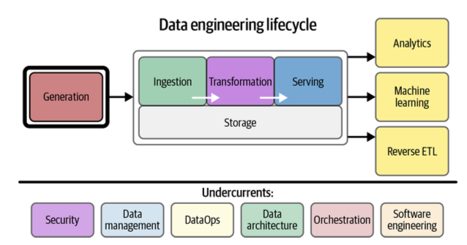
Storage
Cornerstone in the data engineering life cycle
Underlies major stages – ingestion, transformation and serving
Get stored many times when it moved though lifecycle

Slide 3
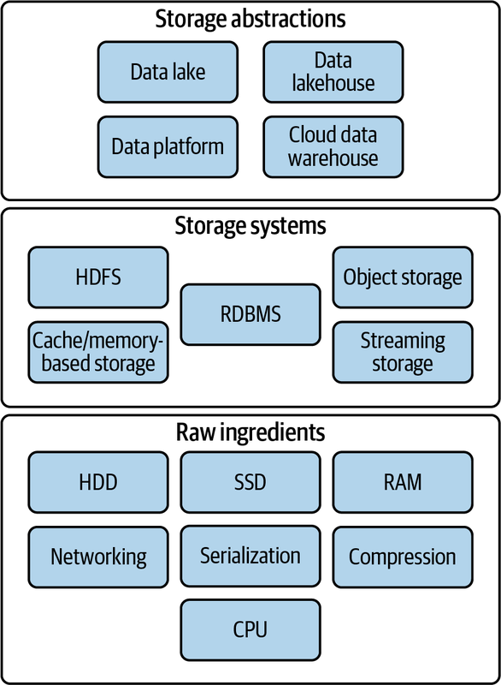
Storage Layering

Slide 4
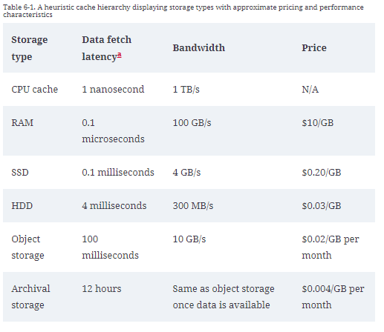
Raw Ingredients of Data Storage
Hardware
Magnetic Disk Drive
Solid-State Drive
Random Access Memory
Networking and CPU
Associated features
Serialization
Compression
Caching

Slide 5
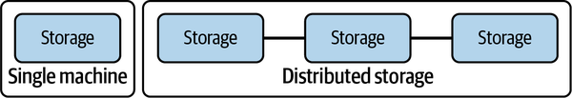
Data Storage Systems
Single Machine Versus Distributed Storage
As data storage and access patterns become more complex and outgrow the usefulness of a single server
distributing data to more than one server becomes necessary
Data can be stored on multiple servers, known as distributed storage
with purpose is to store data in a distributed fashion
Distributed storage coordinates the activities of multiple servers
to store, retrieve, and process data faster and at a larger scale, all while providing redundancy in case a server becomes unavailable
provides built-in redundancy and scalability for large amounts of data
Examples, object storage, Apache Spark, and cloud data warehouses rely on distributed storage architectures

Slide 6
Data Storage Systems(2)
File Storage
A file is a data entity with specific read, write, and reference characteristics used by software and operating systems
A file
has finite length - stream of bytes
supports append operations - append bytes to the files
supports random access - read from any location in the file or write updates to any location
File storage systems organize files into a directory tree
/Users/Pravin/file.txt
The filesystem stores each directory as metadata about the files and directories that it contains
consists of the name of each entity, relevant permission details, and a pointer to the actual entity
To find a file on disk, the operating system looks at the metadata at each hierarchy level and follows the
pointer to the next subdirectory entity until finally reaching the file itself.

Slide 7
Data Storage Systems(3)
File Storage - Types
Local disk storage
The most familiar type of file storage is an operating system–managed filesystem on a local disk partition of SSD or magnetic disc
New Technology File System (NTFS) and ext4 are popular filesystems on Windows and Linux respectively
OS handles the details of storing directory entities, files, and metadata
designed to write data to allow for easy recovery in the event of power loss during a write, though any unwritten data will still be lost.
support full read after write consistency; reading immediately after a write will return the written data
employs various locking strategies to manage concurrent writing attempts to a file
Network-attached storage
provide a file storage system to clients over a network
prevalent solution for servers; they quite often ship with built-in dedicated NAS interface hardware
has performance penalties to accessing the filesystem over a network
significant advantages includes redundancy and reliability, fine-grained control of resources and file sharing across multiple machines
Cloud filesystem services
provide a fully managed filesystem for use with multiple cloud VMs and applications, potentially including clients outside the cloud environment
should not be confused with standard storage attached to VMs—generally, block storage with a filesystem managed by the VM operating system
behave much like NAS solutions, but the details of networking, managing disk clusters, failures, and configuration are fully handled by the cloud vendor
Amazon Elastic File System (EFS) is an extremely popular example of a cloud filesystem service

Slide 8
Data Storage Systems(4)
Block Storage
Fundamentally type of raw storage provided by SSDs and magnetic disks
In the cloud, virtualized block storage is the standard for VMs
allow fine control of storage size, scalability, and data durability beyond that offered by raw disks.
A block is the smallest addressable unit of data supported by a disk
was often 512 bytes of usable data on older disks, but it has now grown to 4,096 bytes for most current disks
also contain extra bits for error detection/correction and other metadata
Blocks on magnetic disks are geometrically arranged on a physical platter
Two blocks on the same track can be read without moving the head, while reading two blocks on separate tracks
requires a seek
Seek time can occur between blocks on an SSD, but this is infinitesimal compared to the seek time for magnetic disk tracks
Block storage applications
Transactional database systems generally access disks at a block level to lay out data for optimal performance
Operating system boot disks on cloud VMs

Slide 9
Data Storage Systems(5)
Block Storage - Types
RAID
redundant array of independent disks
simultaneously controls multiple disks to
improve data durability
enhance performance
combine capacity from multiple drives
an array can appear to the operating system as a single block device
Storage area network (SAN)
provide virtualized block storage devices over a network, typically from a storage pool
allow fine-grained storage scaling and enhance performance, availability, and durability
common with on-premises storage systems

Slide 10
Data Storage Systems(6)
Block Storage - Types
Cloud virtualized block storage
similar to SAN but free engineers from dealing with SAN clusters and networking details
Example, Amazon Elastic Block Store (EBS) - default storage for Amazon EC2 virtual machines
store data separate from the instance host server but in the same zone to support high performance and low latency
allows EBS volumes to persist when an EC2 instance shuts down, when a host server fails, or even when the
instance is deleted
suitable for applications such as databases, where data durability is a high priority
replicates all data to at least two separate host machines, protecting data if a disk fails
Local instance volumes
Cloud providers also offer block storage volumes that are physically attached to the host server running a virtual machine
generally very low cost (included with the price of the VM in the case of Amazon’s EC2 instance store) and provide low latency
when a VM shuts down or is deleted, the contents of the locally attached disk are lost, whether or not this event was caused by intentional user action
ensures that a new virtual machine cannot read disk contents belonging to a different customer

Slide 11
Data Storage Systems(7)
Object Storage
Object Storage
contains objects of all shapes and sizes - a specialized file-like construct —TXT, CSV, JSON, images, videos, or audio
have grown in importance and popularity with the rise of big data and the cloud
Amazon S3, Azure Blob Storage, and Google Cloud Storage (GCS) are widely used
many cloud data warehouses (and a growing number of databases) utilize object storage as their storage layer
cloud data lakes generally sit on object stores
Object storage was arguably one of the first “serverless” services
engineers don’t need to consider the characteristics of underlying server clusters or disks
An object store is a key-value store for immutable data objects.
don’t support random writes or append operations; instead, they are written once as a stream of bytes
After this initial write, objects become immutable
To change data in an object or append data to it, must rewrite the full object

Slide 12
Data Storage Systems(8)
Cache and Memory-Based Storage Systems
RAM offers excellent latency and transfer speeds but extremely vulnerable to data loss
RAM-based storage systems are generally focused on caching applications, presenting data for quick
access and high bandwidth
Data should generally be written to a more durable medium for retention purposes
These ultra-fast cache systems are useful when data engineers need to serve data with ultra-fast retrieval
latency
Memcached and lightweight object caching
a key-value store designed for caching database query results, API call responses, and more
uses simple data structures, supporting either string or integer types
deliver results with very low latency while also taking the load off backend systems
Redis, memory caching with optional persistence
a key-value store, but it supports somewhat more complex data types (such as lists or sets)
with a typical configuration, Redis writes data roughly every two seconds
Redis is thus suitable for extremely high-performance applications but can tolerate a small amount of data
loss

Slide 13
Data Storage Systems(9)
The Hadoop Distributed File System
HDFS is
based on Google File System (GFS) and was initially engineered to process data with the MapReduce programming model
similar to object storage but with a key difference: Hadoop combines compute and storage on the same nodes, where object
stores typically have limited support for internal processing
Management
breaks large files into blocks, chunks of data less than a few hundred megabytes in size
managed by the NameNode, which maintains directories, file metadata, and a detailed catalog describing the location of file
blocks in the cluster
each block of data is replicated to three nodes - increases both the durability and availability of data
Claims that Hadoop is dead! This is only partially true!
no longer a hot, bleeding-edge technology
Many Hadoop ecosystem tools such as Apache Pig are now on life support and primarily used to run legacy jobs
The pure MapReduce programming model has fallen by the wayside
but HDFS remains widely used in various applications and organizations
HDFS is a key ingredient of many current big data engines, such as Amazon EMR
In fact, Apache Spark is still commonly run on HDFS clusters

Slide 14
Data Storage Systems(10)
Streaming Storage
Streaming data has different storage requirements than nonstreaming data - retention, replay!
Retention
In the case of message queues, stored data is temporal and expected to disappear after a certain duration
Distributed, scalable streaming frameworks like Apache Kafka now allow extremely long-duration
streaming data retention
Kafka competitors (including Amazon Kinesis, Apache Pulsar, and Google Cloud Pub/Sub) also support
long data retention
Replay
allows a streaming system to return a range of historical stored data
standard data-retrieval mechanism for streaming storage systems
can be used to run batch queries over a time range or to reprocess data in a streaming pipeline

Slide 15
Data Storage Abstractions
Data engineering storage abstractions are data organization and query patterns that sit at the
heart of the data engineering lifecycle
are built atop the data storage systems
The main types of abstractions are those that support data science, analytics, and reporting use cases
Data warehouse
Data lake
Data lakehouse
Data platforms

Slide 16
Thank You!
In our next session:

